Slide 1


Presentation Link : https://github.com/TOWHIDCSE4/SOLID_presentation-/blob/main/TechviFy_SOLID.pptx
SOLID Principles
August -2022​
Created by
Islam Towhidul​

Slide 2
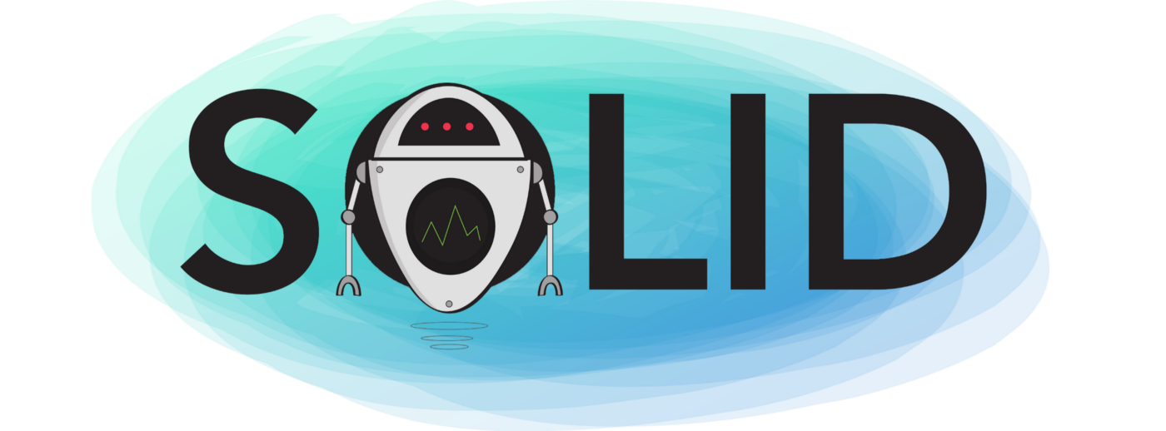
Contents
What is SOLID
Why important SOLID principles
Single Responsibility Principle (SRP)
Open/Closed Principle
Liskov’s Substitution Principle (LSP)
Interface Segregation Principle (ISP)
Dependency Inversion Principle (DIP)
Presentation Link : https://github.com/TOWHIDCSE4/SOLID_presentation-/blob/main/TechviFy_SOLID.pptx

Slide 3
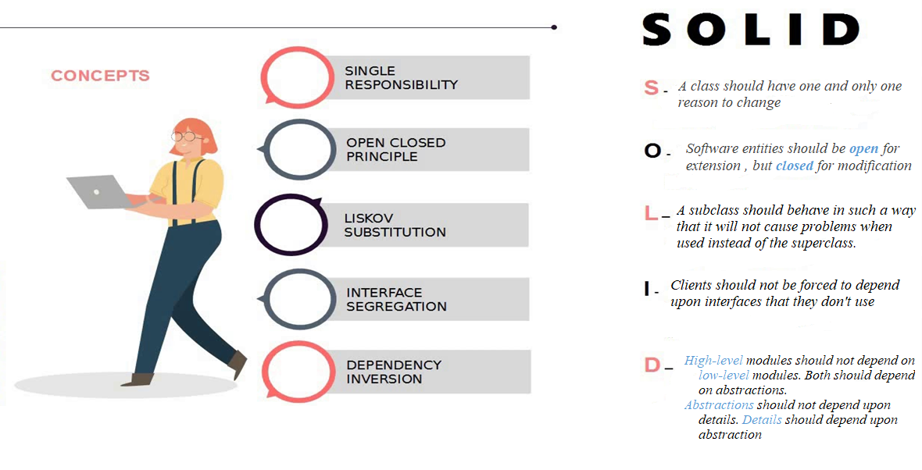
The SOLID principles of Object-Oriented Design include the following 5 principles:
Presentation Link : https://github.com/TOWHIDCSE4/SOLID_presentation-/blob/main/TechviFy_SOLID.pptx

Slide 4

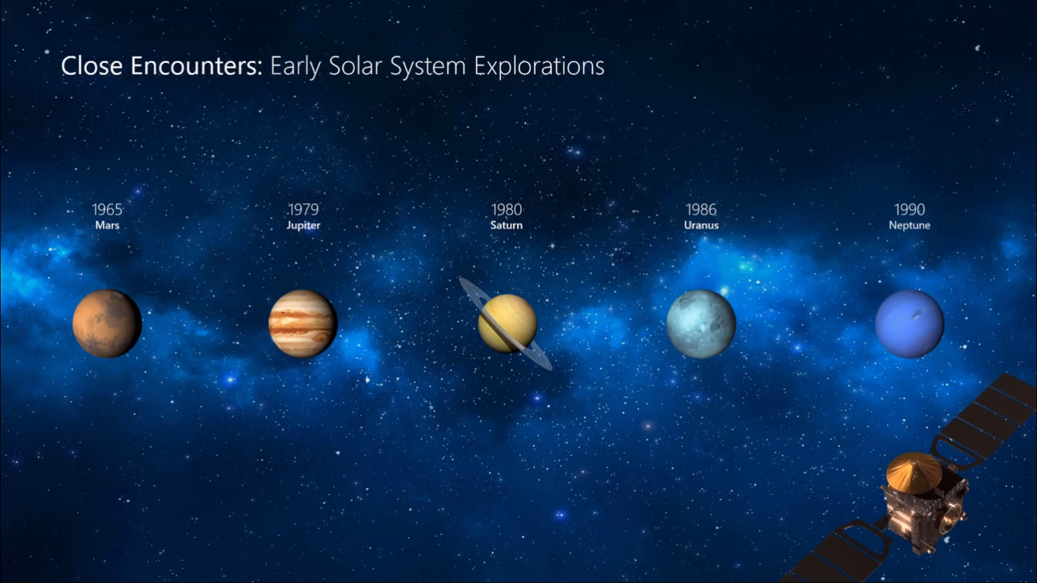
Why important SOLID principles?
The SOLID principles were developed to combat these problematic design patterns. The broad goal of the SOLID principles is to reduce dependencies so that engineers change one area of software without impacting others. Additionally, they're intended to make designs easier to understand, maintain, and extend.
Presentation Link : https://github.com/TOWHIDCSE4/SOLID_presentation-/blob/main/TechviFy_SOLID.pptx

Slide 5
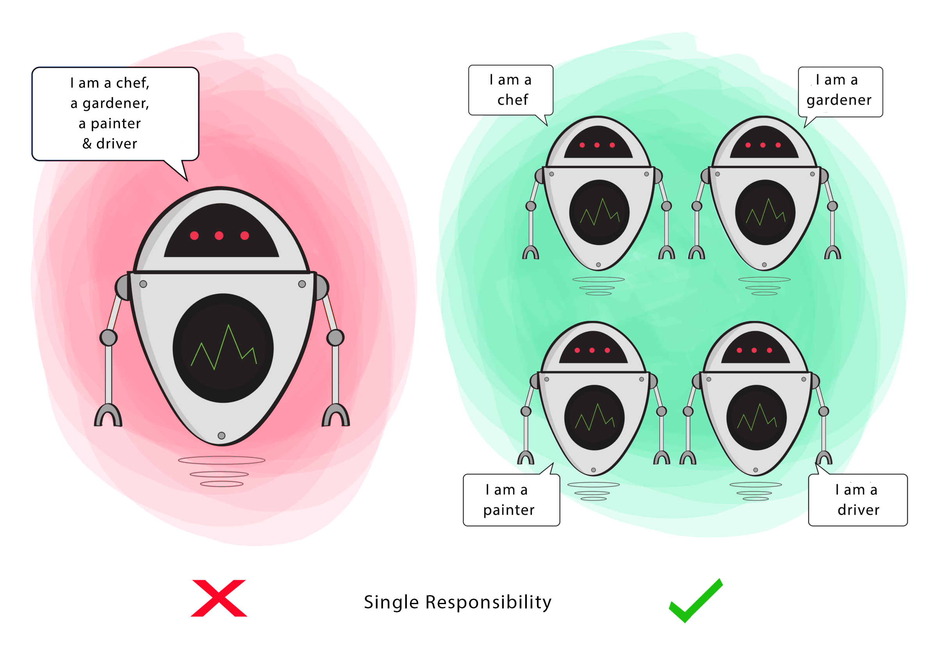
Single Responsibility Principle (SRP)
The more responsibility a class has, the more likely it is to introduce bugs. This is because making changes to one of those responsibilities can unknowingly affect other responsibilities.
Purpose
This principle aims to isolate behavior so that even if a change results in a bug, it doesn't affect other unrelated behavior.

Slide 6
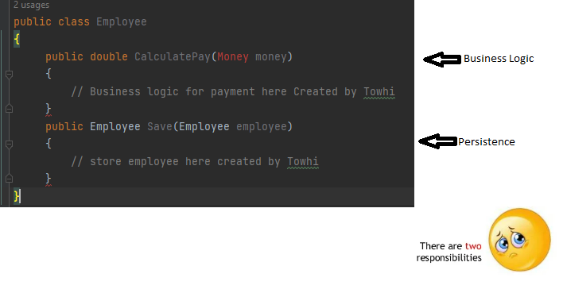
Single Responsibility Principle (SRP)
"A class should have one and only one reason to change"
Presentation Link : https://github.com/TOWHIDCSE4/SOLID_presentation-/blob/main/TechviFy_SOLID.pptx

Slide 7

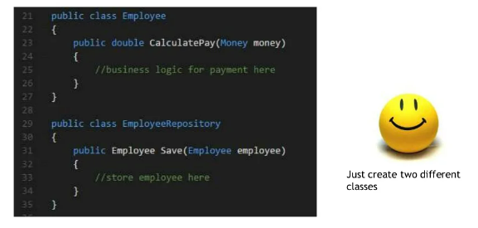
Single Responsibility Principle (SRP)
How to Solve this ?
Presentation Link : https://github.com/TOWHIDCSE4/SOLID_presentation-/blob/main/TechviFy_SOLID.pptx

Slide 8
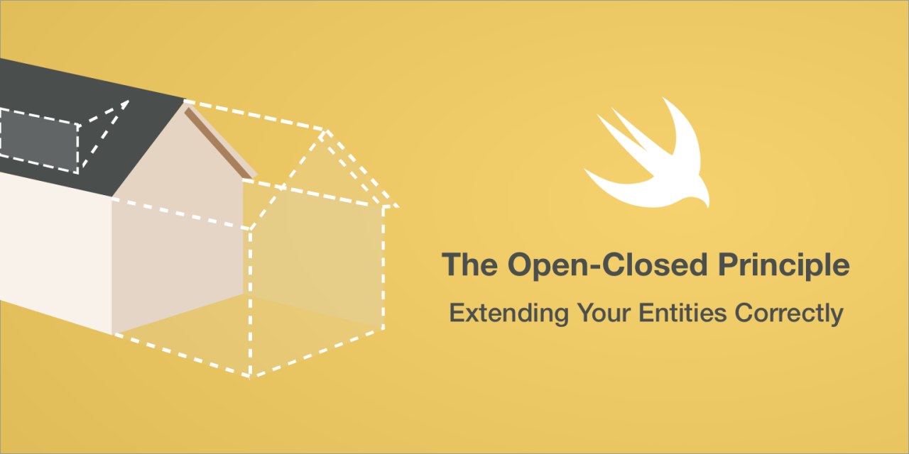
Open/Closed Principle
"Software entities should be open for extension , but closed for modification"
Presentation Link : https://github.com/TOWHIDCSE4/SOLID_presentation-/blob/main/TechviFy_SOLID.pptx

Slide 9
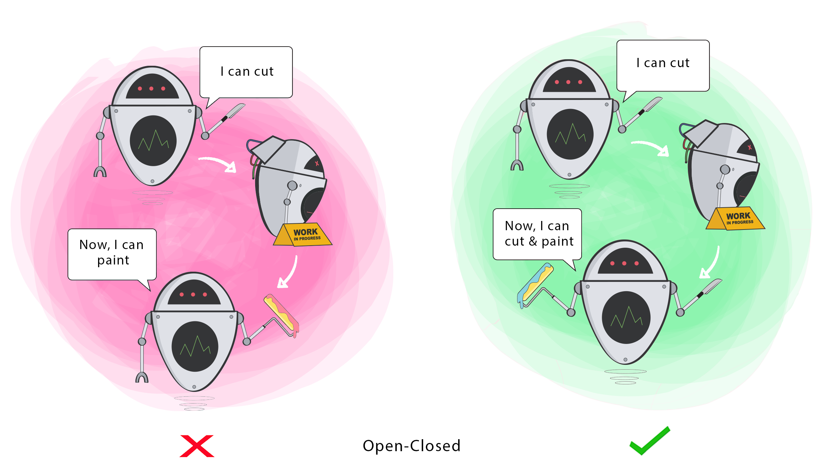
Open/Closed Principle
Changing the current behavior of a class affects all systems that use that class.
When you want to perform more functions in your class, the ideal way is to add to existing functions, not change them .
Purpose
This principle aims to extend the behavior of a class without changing the existing behavior of the class. This is to avoid bugs where the class is used.

Slide 10
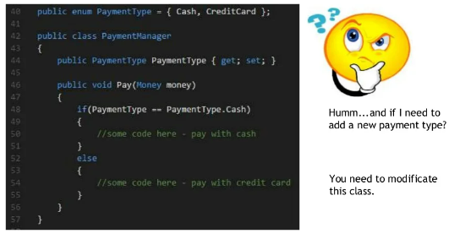
Open/Closed Principle
Presentation Link : https://github.com/TOWHIDCSE4/SOLID_presentation-/blob/main/TechviFy_SOLID.pptx

Slide 11
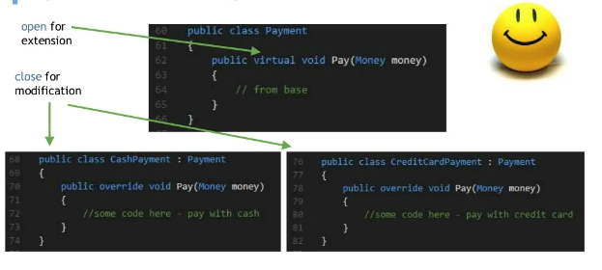
Open/Closed Principle
The inheritance is a good way to apply the OCP; we don’t change the source code of the Payment class. But we introduced coupling between it and the CashPayment and CreditCardPayment class. In a real example, you will use inheritance with concrete classes that have many methods, and sometimes we don’t need this coupling.
What I loved about software engineering is that always there is a better way, 🤗
Presentation Link : https://github.com/TOWHIDCSE4/SOLID_presentation-/blob/main/TechviFy_SOLID.pptx

Slide 12
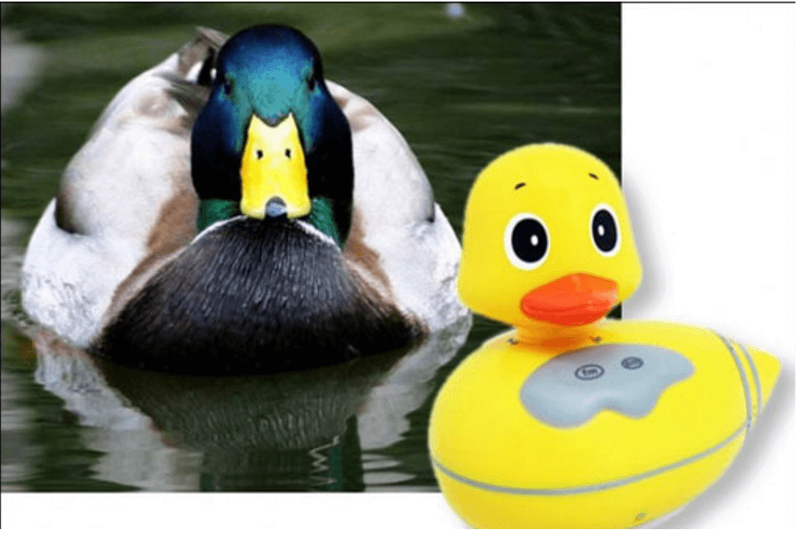
Liskov’s Substitution Principle (LSP)
"A subclass should behave in such a way that it will not cause problems when used instead of the superclass"
Presentation Link : https://github.com/TOWHIDCSE4/SOLID_presentation-/blob/main/TechviFy_SOLID.pptx

Slide 13
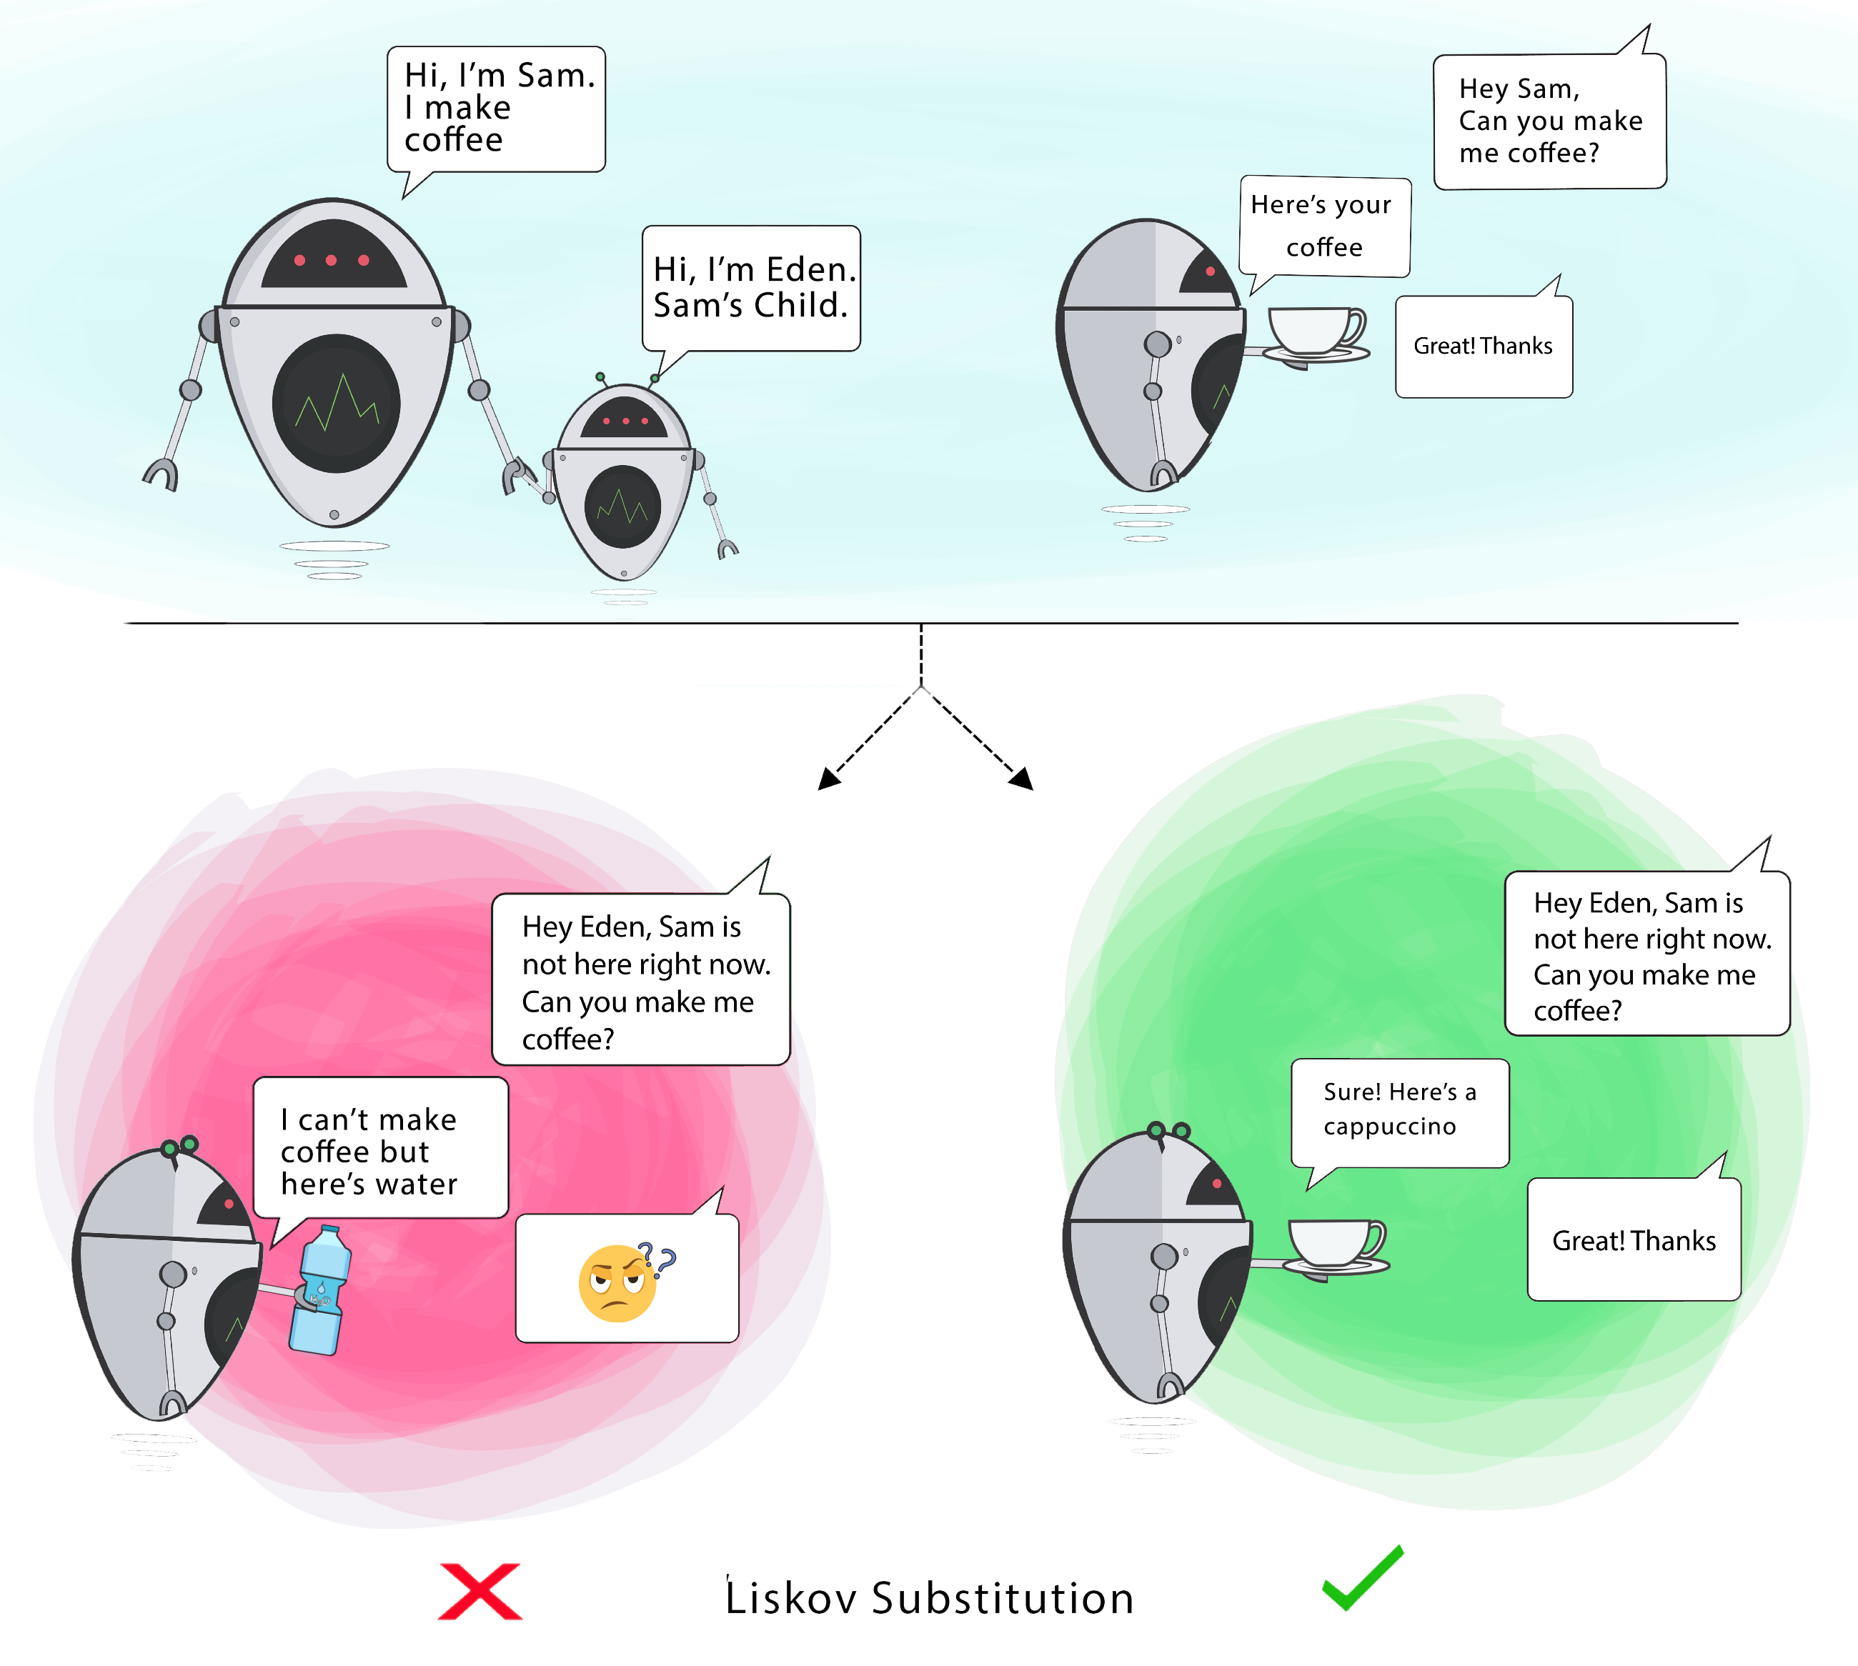
Liskov’s Substitution Principle (LSP)
It can be a bug if the child class cannot perform the same behavior as the parent class.
When you create another class from a class, the class becomes the parent and the new class becomes the child . The child class should be able to do everything the parent class can do. This process is called inheritance .
A child class must be able to handle the same requests and provide the same or similar results as the parent class.
In this illustration, the parent class is serving coffee (any type of coffee). It is acceptable for a child class to serve cappuccinos because cappuccinos are a type of coffee, but not for water.
If the child class does not meet these requirements, then the child class has changed so much that it violates this principle.
Purpose
This principle is intended to be consistent so that the parent class and its child classes can be used in the same way without error.

Slide 14
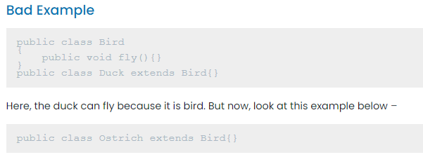

Liskov’s Substitution Principle (LSP)
Presentation Link : https://github.com/TOWHIDCSE4/SOLID_presentation-/blob/main/TechviFy_SOLID.pptx

Slide 15
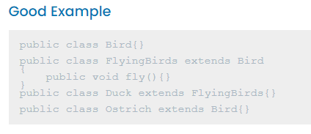

Liskov’s Substitution Principle (LSP)
Presentation Link : https://github.com/TOWHIDCSE4/SOLID_presentation-/blob/main/TechviFy_SOLID.pptx

Slide 16
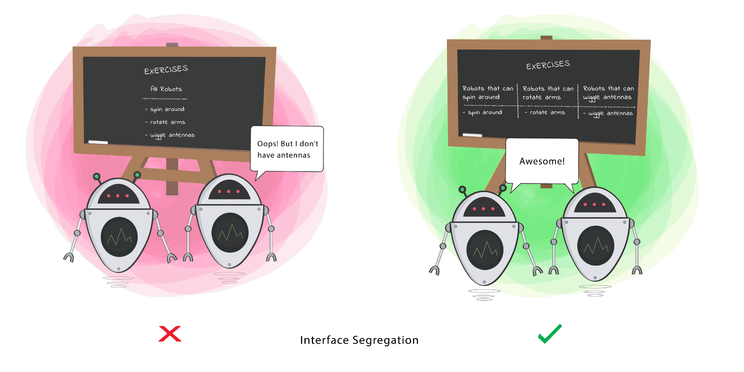
Trying to force a class to do something it doesn't want is wasteful and can lead to unexpected bugs if the class doesn't have the ability to do it. A class should only perform the actions necessary to fulfill its role. Any other behavior should be removed entirely or moved elsewhere if there is a possibility that other classes might use it in the future. Purpose The principle is to split the set of behaviors into smaller pieces so that the class does only what it needs to do.
Interface Segregation Principle (ISP)

Slide 17
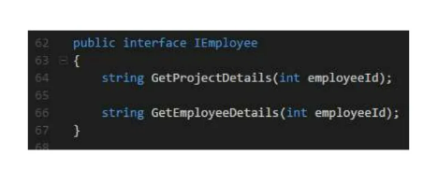
Interface Segregation Principle (ISP)
"Clients should not be forced to depend upon interfaces that they don't use"
Presentation Link : https://github.com/TOWHIDCSE4/SOLID_presentation-/blob/main/TechviFy_SOLID.pptx

Slide 18
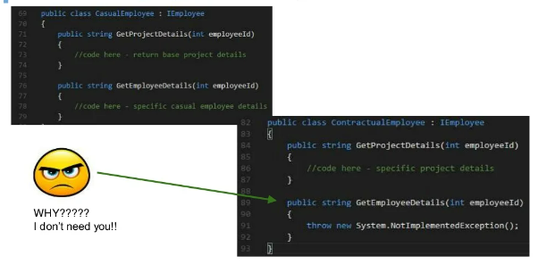
Interface Segregation Principle (ISP)
Presentation Link : https://github.com/TOWHIDCSE4/SOLID_presentation-/blob/main/TechviFy_SOLID.pptx

Slide 19
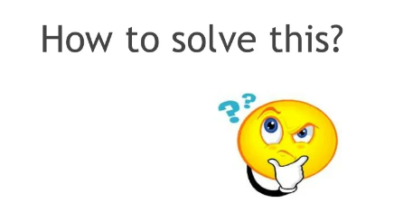
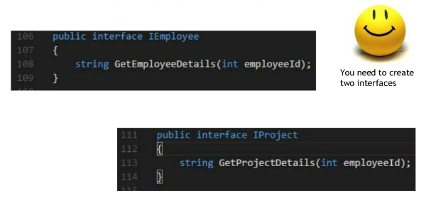
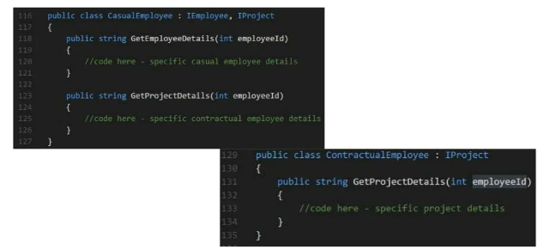
Interface Segregation Principle (ISP)
Presentation Link : https://github.com/TOWHIDCSE4/SOLID_presentation-/blob/main/TechviFy_SOLID.pptx

Slide 20
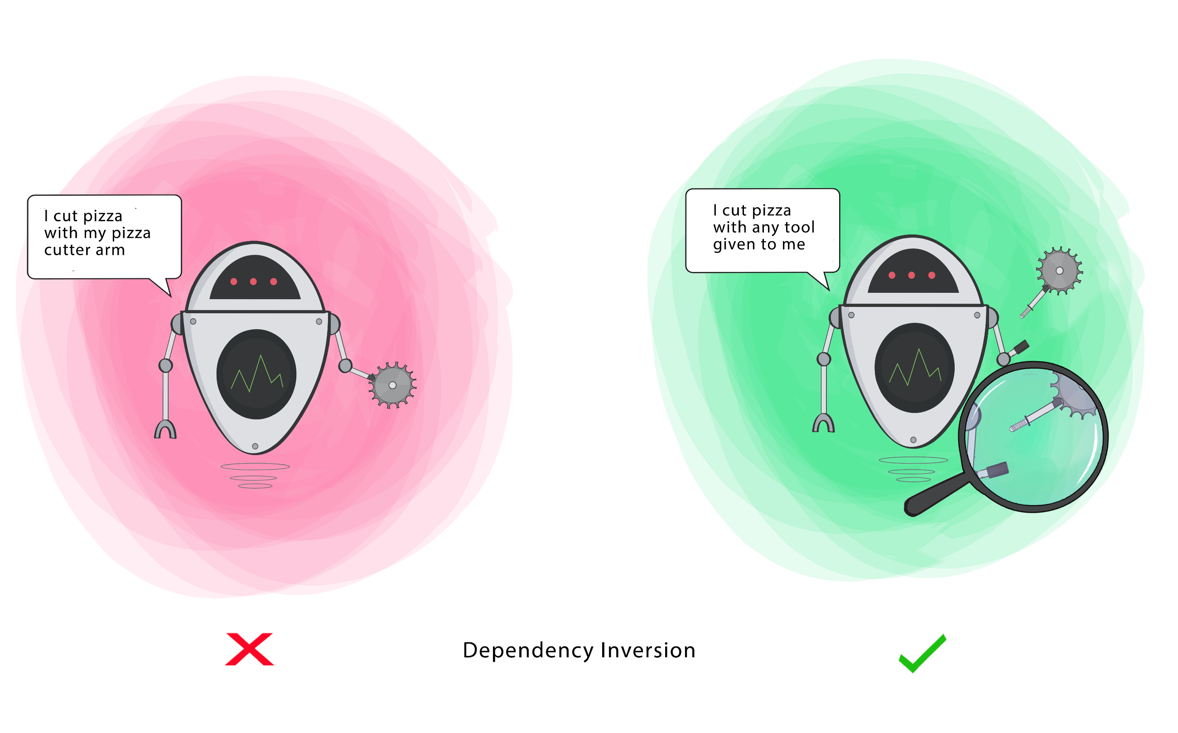
Dependency Inversion Principle (DIP)
"High-level modules should not depend on low-level modules. Both should depend on abstractions."
"Abstractions should not depend upon details. Details should depend upon abstraction"

Slide 21
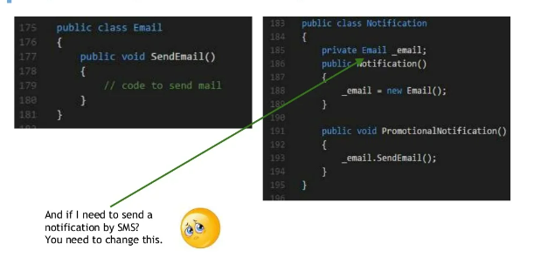
Dependency Inversion Principle (DIP)
Dependency injection is a programming technique that makes a class independent of its dependencies. It achieves that by decoupling the usage of an object from its creation. This helps you to follow SOLID's dependency inversion and single responsibility principles.
Presentation Link : https://github.com/TOWHIDCSE4/SOLID_presentation-/blob/main/TechviFy_SOLID.pptx

Slide 22
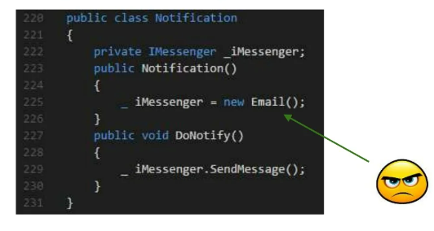
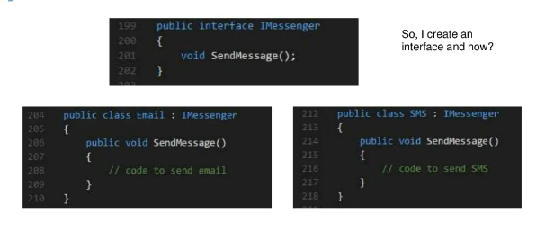
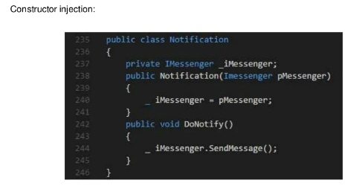
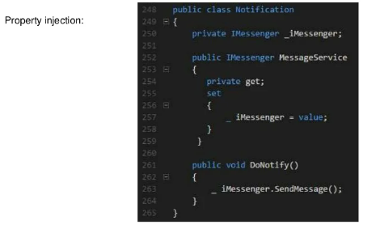
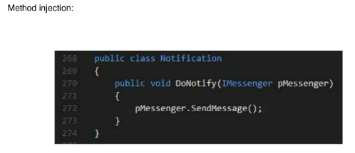
Dependency Inversion Principle (DIP)
Presentation Link : https://github.com/TOWHIDCSE4/SOLID_presentation-/blob/main/TechviFy_SOLID.pptx

Slide 23

Keep in Mind
DRY - Don't repeat yourself
+
SLAP - Single layer abstraction principle
+
SOLID
BEST DEVELOPER
Presentation Link : https://github.com/TOWHIDCSE4/SOLID_presentation-/blob/main/TechviFy_SOLID.pptx

Slide 24
Keep in Mind
Enjoy code and
Keep it simple!
Presentation Link : https://github.com/TOWHIDCSE4/SOLID_presentation-/blob/main/TechviFy_SOLID.pptx

Slide 25

Thank you All
Presentation Link : https://github.com/TOWHIDCSE4/SOLID_presentation-/blob/main/TechviFy_SOLID.pptx

Slide 26
Contents
What is SOLID
Why important SOLID principles
Single Responsibility Principle (SRP)
Open/Closed Principle
Liskov’s Substitution Principle (LSP)
Interface Segregation Principle (ISP)
Dependency Inversion Principle (DIP)

Slide 27
The SOLID principles of Object-Oriented Design include the following 5 principles:

Slide 28
Why important SOLID principles?
The SOLID principles were developed to combat these problematic design patterns. The broad goal of the SOLID principles is to reduce dependencies so that engineers change one area of software without impacting others. Additionally, they're intended to make designs easier to understand, maintain, and extend.

Slide 29
Single Responsibility Principle (SRP)
"A class should have one and only one reason to change"

Slide 30
Single Responsibility Principle (SRP)
How to Solve this ?

Slide 31
Open/Closed Principle
"Software entities should be open for extension , but closed for modification"

Slide 32
Open/Closed Principle

Slide 33
Open/Closed Principle
The inheritance is a good way to apply the OCP; we don’t change the source code of the Payment class. But we introduced coupling between it and the CashPayment and CreditCardPayment class. In a real example, you will use inheritance with concrete classes that have many methods, and sometimes we don’t need this coupling.
What I loved about software engineering is that always there is a better way, 🤗

Slide 34
Liskov’s Substitution Principle (LSP)
"A subclass should behave in such a way that it will not cause problems when used instead of the superclass"

Slide 35
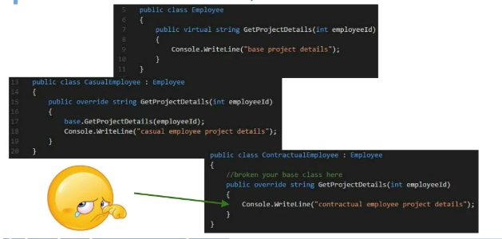
Liskov’s Substitution Principle (LSP)

Slide 36
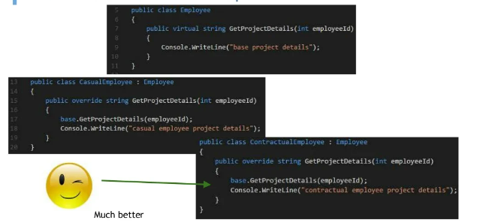
Liskov’s Substitution Principle (LSP)

Slide 37
Liskov’s Substitution Principle (LSP)

Slide 38
Interface Segregation Principle (ISP)
"Clients should not be forced to depend upon interfaces that they don't use"

Slide 39
Interface Segregation Principle (ISP)

Slide 40
Interface Segregation Principle (ISP)

Slide 41
Dependency Inversion Principle (DIP)
"High-level modules should not depend on low-level modules. Both should depend on abstractions."
"Abstractions should not depend upon details. Details should depend upon abstraction"

Slide 42
Dependency Inversion Principle (DIP)

Slide 43
Keep in Mind
DRY - Don't repeat yourself
+
SLAP - Single layer abstraction principle
+
SOLID
BEST DEVELOPER

Slide 44
Keep in Mind
Enjoy code and
Keep it simple!

Slide 45
Thank You

